Slide 1
Java Training Day 4

Slide 2
Java JDBC Tutorial

Slide 3
Java JDBC is a java API to connect and execute query with the database. JDBC API uses jdbc drivers to connect with the database.

Slide 4
Why use JDBC
Before JDBC, ODBC API was the database API to connect and execute query with the database. But, ODBC API uses ODBC driver which is written in C language (i.e. platform dependent and unsecured). That is why Java has defined its own API (JDBC API) that uses JDBC drivers (written in Java language).

Slide 5
What is API
API (Application programming interface) is a document that contains description of all the features of a product or software. It represents classes and interfaces that software programs can follow to communicate with each other. An API can be created for applications, libraries, operating systems, etc

Slide 6
JDBC Driver
JDBC Driver is a software component that enables java application to interact with the database.There are 4 types of JDBC drivers:
JDBC-ODBC bridge driver
Native-API driver (partially java driver)
Network Protocol driver (fully java driver)
Thin driver (fully java driver)

Slide 7
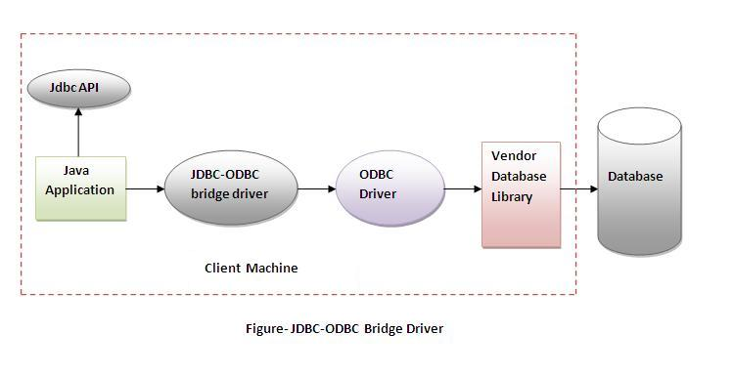
1) JDBC-ODBC bridge driver

Slide 8
Advantages:
easy to use.
can be easily connected to any database.
Disadvantages:
Performance degraded because JDBC method call is converted into the ODBC function calls.
The ODBC driver needs to be installed on the client machine.

Slide 9
2) Native-API driver
The Native API driver uses the client-side libraries of the database. The driver converts JDBC method calls into native calls of the database API. It is not written entirely in java.

Slide 10
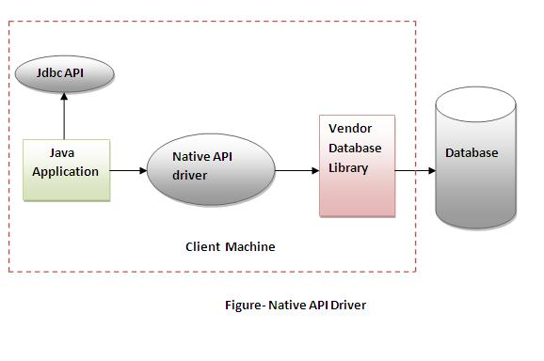

Slide 11
Advantage:
performance upgraded than JDBC-ODBC bridge driver.
Disadvantage:
The Native driver needs to be installed on the each client machine.
The Vendor client library needs to be installed on client machine.

Slide 12
3) Network Protocol driver
The Network Protocol driver uses middleware (application server) that converts JDBC calls directly or indirectly into the vendor-specific database protocol. It is fully written in java.

Slide 13
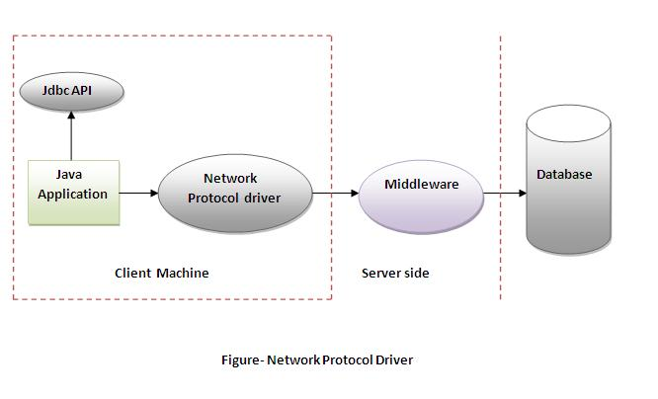

Slide 14
Advantage:
No client side library is required because of application server that can perform many tasks like auditing, load balancing, logging etc.
Disadvantages:
Network support is required on client machine.
Requires database-specific coding to be done in the middle tier.
Maintenance of Network Protocol driver becomes costly because it requires database-specific coding to be done in the middle tier.

Slide 15
4) Thin driver
The thin driver converts JDBC calls directly into the vendor-specific database protocol. That is why it is known as thin driver. It is fully written in Java language.

Slide 16
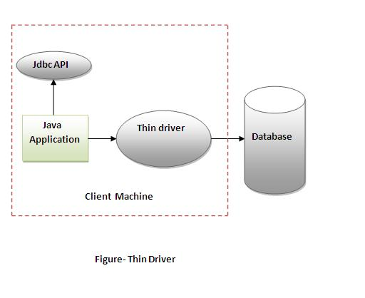

Slide 17
Advantage:
Better performance than all other drivers.
No software is required at client side or server side.
Disadvantage:
Drivers depends on the Database.

Slide 18
5 Steps to connect to the database in java
There are 5 steps to connect any java application with the database in java using JDBC. They are as follows:
Register the driver class
Creating connection
Creating statement
Executing queries
Closing connection

Slide 19
1) Register the driver class
The forName() method of Class class is used to register the driver class. This method is used to dynamically load the driver class.
Syntax of forName() method
public static void forName(String className) throws ClassNotFoundException
Example to register the OracleDriver class
Class.forName("oracle.jdbc.driver.OracleDriver");

Slide 20
2) Create the connection object
The getConnection() method of DriverManager class is used to establish connection with the database.
Syntax of getConnection() method
1) public static Connection getConnection(String url)throws SQLException
2) public static Connection getConnection(String url,String name,String password)
throws SQLException
Example to establish connection with the Oracle database
Connection con=DriverManager.getConnection(
"jdbc:oracle:thin:@localhost:1521:xe","system","password");

Slide 21
3 Create the Statement object
The createStatement() method of Connection interface is used to create statement. The object of statement is responsible to execute queries with the database.
Syntax of createStatement() method
public Statement createStatement()throws SQLException
Example to create the statement object
Statement stmt=con.createStatement();

Slide 22
4) Execute the query
The executeQuery() method of Statement interface is used to execute queries to the database. This method returns the object of ResultSet that can be used to get all the records of a table.
Syntax of executeQuery() method
public ResultSet executeQuery(String sql)throws SQLException
Example to execute query
ResultSet rs=stmt.executeQuery("select * from emp");
while(rs.next())
{
System.out.println(rs.getInt(1)+" "+rs.getString(2));
}

Slide 23
5) Close the connection object
By closing connection object statement and ResultSet will be closed automatically. The close() method of Connection interface is used to close the connection.
Syntax of close() method
public void close()throws SQLException
Example to close connection
con.close();

Slide 24
What is MySQL
MySQL is a fast, easy to use relational database. It is currently the most popular open-source database. It is very commonly used in conjunction with PHP scripts to create powerful and dynamic server-side applications.

Slide 25
Reasons of popularity
MySQL is an open-source database so you don't have to pay a single penny to use it.
MySQL is customizable because it is an open source database and the open-source GPL license facilitates programmers to modify the SQL software according to their own specific environment.
MySQL is quicker than other databases so it can work well even with the large data set.
MySQL supports many operating systems with many languages like PHP, PERL, C, C++, JAVA, etc.

Slide 26
MySQL uses a standard form of the well-known SQL data language.
MySQL is very friendly with PHP, the most popular language for web development.
MySQL supports large databases, up to 50 million rows or more in a table. The default file size limit for a table is 4GB, but you can increase this (if your operating system can handle it) to a theoretical limit of 8 million terabytes (TB).

Slide 27
Example to connect to the mysql database in java
For connecting java application with the mysql database, you need to follow 5 steps to perform database connectivity.
In this example we are using MySql as the database. So we need to know following informations for the mysql database:
Driver class: The driver class for the mysql database is com.mysql.jdbc.Driver.
Connection URL: The connection URL for the mysql database is jdbc:mysql://localhost:3306/cloud where jdbc is the API, mysql is the database, localhost is the server name on which mysql is running, we may also use IP address, 3306 is the port number and sonoo is the database name. We may use any database, in such case, you need to replace the sonoo with your database name.
Username: The default username for the mysql database is root.
Password: Password is given by the user at the time of installing the mysql database. In this example, we are going to use root as the password.

Slide 28
DriverManager class
The DriverManager class acts as an interface between user and drivers. It keeps track of the drivers that are available and handles establishing a connection between a database and the appropriate driver. The DriverManager class maintains a list of Driver classes that have registered themselves by calling the method DriverManager.registerDriver().

Slide 29
Commonly used methods of DriverManager class:
1) public static void registerDriver(Driver driver):is used to register the given driver with DriverManager.
2) public static void deregisterDriver(Driver driver):is used to deregister the given driver (drop the driver from the list) with DriverManager.
3) public static Connection getConnection(String url):is used to establish the connection with the specified url.
4) public static Connection getConnection(String url,String userName,String password):is used to establish the connection with the specified url, username and password.

Slide 30
Connection interface
A Connection is the session between java application and database. The Connection interface is a factory of Statement, PreparedStatement, and DatabaseMetaData i.e. object of Connection can be used to get the object of Statement and DatabaseMetaData. The Connection interface provide many methods for transaction management like commit(), rollback() etc.
1) public Statement createStatement(): creates a statement object that can be used to execute SQL queries.
2) public void close(): closes the connection and Releases a JDBC resources immediately.

Slide 31
Statement interface
The Statement interface provides methods to execute queries with the database. The statement interface is a factory of ResultSet i.e. it provides factory method to get the object of ResultSet.
1) public ResultSet executeQuery(String sql): is used to execute SELECT query. It returns the object of ResultSet.
2) public int executeUpdate(String sql): is used to execute specified query, it may be create, drop, insert, update, delete etc.
3) public int[] executeBatch(): is used to execute batch of commands.

Slide 32
ResultSet interface
The object of ResultSet maintains a cursor pointing to a row of a table. Initially, cursor points to before the first row.
1) public boolean next():is used to move the cursor to the one row next from the current position.
2) public int getInt(int columnIndex):is used to return the data of specified column index of the current row as int.
3) public int getInt(String columnName):is used to return the data of specified column name of the current row as int.
4) public String getString(int columnIndex):is used to return the data of specified column index of the current row as String.
5) public String getString(String columnName):is used to return the data of specified column name of the current row as String.

Slide 33
PreparedStatement interface
The PreparedStatement interface is a subinterface of Statement. It is used to execute parameterized query.
String sql="insert into emp values(?,?,?)";
As you can see, we are passing parameter (?) for the values. Its value will be set by calling the setter methods of PreparedStatement.

Slide 34
Why use PreparedStatement?
Improves performance: The performance of the application will be faster if you use PreparedStatement interface because query is compiled only once.

Slide 35
Method | Description
public void setInt(int paramIndex, int value) | sets the integer value to the given parameter index.
public void setString(int paramIndex, String value) | sets the String value to the given parameter index.
public void setFloat(int paramIndex, float value) | sets the float value to the given parameter index.
public void setDouble(int paramIndex, double value) | sets the double value to the given parameter index.
public int executeUpdate() | executes the query. It is used for create, drop, insert, update, delete etc.
public ResultSet executeQuery() | executes the select query. It returns an instance of ResultSet.

Slide 36
MySQL Features
Relational Database Management System (RDBMS): MySQL is a relational database management system.
Easy to use: MySQL is easy to use. You have to get only the basic knowledge of SQL. You can build and interact with MySQL with only a few simple SQL statements.
It is secure: MySQL consist of a solid data security layer that protects sensitive data from intruders. Passwords are encrypted in MySQL.
Client/ Server Architecture: MySQL follows a client /server architecture. There is a database server (MySQL) and arbitrarily many clients (application programs), which communicate with the server; that is, they query data, save changes, etc.
Free to download: MySQL is free to use and you can download it from MySQL official website.
It is scalable: MySQL can handle almost any amount of data, up to as much as 50 million rows or more. The default file size limit is about 4 GB. However, you can increase this number to a theoretical limit of 8 TB of data.

Slide 37
Compatibale on many operating systems: MySQL is compatible to run on many operating systems, like Novell NetWare, Windows* Linux*, many varieties of UNIX* (such as Sun* Solaris*, AIX, and DEC* UNIX), OS/2, FreeBSD*, and others. MySQL also provides a facility that the clients can run on the same computer as the server or on another computer (communication via a local network or the Internet).
Allows roll-back: MySQL allows transactions to be rolled back, commit and crash recovery.
High Performance: MySQL is faster, more reliable and cheaper because of its unique storage engine architecture.
High Flexibility: MySQL supports a large number of embedded applications which makes MySQL very flexible.
High Productivity: MySQL uses Triggers, Stored procedures and views which allows the developer to give a higher productivity.

Slide 38
MySQL Create Database
Syntax:
CREATE DATABASE database_name;
Example:
Let's take an example to create a database name "employees"
CREATE DATABASE employees;

Slide 39
MySQL SELECT Database
SELECT Database is used in MySQL to select a particular database to work with. This query is used when multiple databases are available with MySQL Server.
You can use SQL command USE to select a particular database.
Syntax:
USE database_name;
Example:
Let's take an example to use a database name "customers".
USE customers;

Slide 40
MySQL CREATE TABLE
The MySQL CREATE TABLE command is used to create a new table into the database. A table creation command requires three things:
Name of the table
Names of fields
Definitions for each field
Syntax:
Following is a generic syntax for creating a MySQL table in the database.
CREATE TABLE table_name (column_name column_type...);

Slide 41
CREATE TABLE cus_tbl
(
cus_id INT NOT NULL AUTO_INCREMENT,
cus_firstname VARCHAR(100) NOT NULL,
cus_surname VARCHAR(100) NOT NULL,
PRIMARY KEY ( cus_id )
)
Here, NOT NULL is a field attribute and it is used because we don't want this field to be NULL. If you will try to create a record with NULL value, then MySQL will raise an error.
The field attribute AUTO_INCREMENT specifies MySQL to go ahead and add the next available number to the id field.PRIMARY KEY is used to define a column as primary key. You can use multiple columns separated by comma to define a primary key.

Slide 42
import java.sql.*;
class FetchRecord{
public static void main(String args[])throws Exception{
Class.forName("com.mysql.jdbc.Driver"); //1
Connection con=DriverManager.getConnection"jdbc:mysql://localhost:3306/cloud","root","root"); //2
Statement stmt=con.createStatement(); //3
ResultSet rs=stmt.executeQuery("select * from emp"); //4
While(rs.next())//5
{
System.out.println(rs.getString(1)+" "+rs.getString(2)+" "+rs.getString(3)); //6
con.close(); //7
}}}

Slide 43
Java CallableStatement Interface
CallableStatement interface is used to call the stored procedures and functions.
We can have business logic on the database by the use of stored procedures and functions that will make the performance better because these are precompiled.
Suppose you need the get the age of the employee based on the date of birth, you may create a function that receives date as the input and returns age of the employee as the output.

Slide 44
What is the difference between stored procedures and functions.
The differences between stored procedures and functions are given below:
Stored Procedure | Function
is used to perform business logic. | is used to perform calculation.
must not have the return type. | must have the return type.
may return 0 or more values. | may return only one values.
We can call functions from the procedure. | Procedure cannot be called from function.
Procedure supports input and output parameters. | Function supports only input parameter.
Exception handling using try/catch block can be used in stored procedures. | Exception handling using try/catch can't be used in user defined functions.

Slide 45
How to get the instance of CallableStatement?
The prepareCall() method of Connection interface returns the instance of CallableStatement. Syntax is given below:
public CallableStatement prepareCall("{ call procedurename(?,?...?)}");
The example to get the instance of CallableStatement is given below:
CallableStatement stmt=con.prepareCall("{call myprocedure(?,?)}");
It calls the procedure myprocedure that receives 2 arguments.

Slide 46
STORED PROCEDURE create or replace procedure "INSERTR" (id IN NUMBER, name IN VARCHAR2) is begin insert into user values(id,name); end; / | TABLE STRUCTURE create table user (id number(10), name varchar2(200));

Slide 47
import java.sql.*;
public class Proc {
public static void main(String[] args) throws Exception{
Class.forName("com.mysql.jdbc.Driver");
Connection con=DriverManager.getConnection(
"jdbc:mysql://localhost:3306/cloud",“root",“root");
CallableStatement stmt=con.prepareCall("{call insertR(?,?)}");
stmt.setInt(1,1011);
stmt.setString(2,"Amit");
stmt.execute();
System.out.println("success");
}
}

Slide 48
call the function using JDBC
we are calling the sum4 function that receives two input and returns the sum of the given number. Here, we have used the registerOutParameter method of CallableStatement interface, that registers the output parameter with its corresponding type. It provides information to the CallableStatement about the type of result being displayed.
The Types class defines many constants such as INTEGER, VARCHAR, FLOAT, DOUBLE, BLOB, CLOB etc.

Slide 49
create or replace function sum4
(n1 in number,n2 in number)
return number
is
temp number(8);
begin
temp :=n1+n2;
return temp;
end;
/

Slide 50
import java.sql.*;
public class FuncSum {
public static void main(String[] args) throws Exception
{
Class.forName("com.mysql.jdbc.Driver");
Connection con=DriverManager.getConnection( "jdbc:mysql://localhost:3306/cloud","root","root");
CallableStatement stmt=con.prepareCall("{?= call sum4(?,?)}");
stmt.setInt(2,10);
stmt.setInt(3,43);
stmt.registerOutParameter(1,Types.INTEGER);
stmt.execute();
System.out.println(stmt.getInt(1));
}
}

Slide 51
Transaction Management in JDBC
Transaction represents a single unit of work.
The ACID properties describes the transaction management well. ACID stands for Atomicity, Consistency, isolation and durability.
Atomicity means either all successful or none.
Consistency ensures bringing the database from one consistent state to another consistent state.
Isolation ensures that transaction is isolated from other transaction.
Durability means once a transaction has been committed, it will remain so, even in the event of errors, power loss etc.

Slide 52
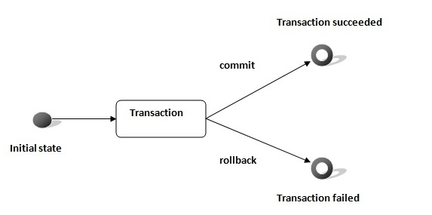
Advantage of Transaction Mangaement
fast performance It makes the performance fast because database is hit at the time of commit.

Slide 53
In JDBC, Connection interface provides methods to manage transaction.
Method | Description
void setAutoCommit(boolean status) | It is true bydefault means each transaction is committed bydefault.
void commit() | commits the transaction.
void rollback() | cancels the transaction.

Slide 54
import java.sql.*;
class FetchRecords{
public static void main(String args[])throws Exception{
Class.forName("com.mysql.jdbc.Driver");
Connection con=DriverManager.getConnection("jdbc:mysql://localhost:3306/cloud","root","root");
con.setAutoCommit(false);
Statement stmt=con.createStatement();
stmt.executeUpdate("insert into user420 values(190,'abhi',40000)");
stmt.executeUpdate("insert into user420 values(191,'umesh',50000)");
con.commit();
con.close();
}}

Slide 55
Batch Processing in JDBC
Instead of executing a single query, we can execute a batch (group) of queries. It makes the performance fast.
The java.sql.Statement and java.sql.PreparedStatement interfaces provide methods for batch processing.
Advantage of Batch Processing
Fast Performance

Slide 56
Methods of Statement interface
Method | Description
void addBatch(String query) | It adds query into batch.
int[] executeBatch() | It executes the batch of queries.
Load the driver class
Create Connection
Create Statement
Add query in the batch
Execute Batch
Close Connection

Slide 57
import java.sql.*;
class FetchRecords{
public static void main(String args[])throws Exception{
Class.forName(" com.mysql.jdbc.Driver ");
Connection con=DriverManager.getConnection "jdbc:mysql://localhost:3306/cloud","root","root");
con.setAutoCommit(false);
Statement stmt=con.createStatement();
stmt.addBatch("insert into user values(190,'abhi',40000)");
stmt.addBatch("insert into user values(191,'umesh',50000)");
stmt.executeBatch();//executing the batch
con.commit();
con.close();
}}

